Slide 1
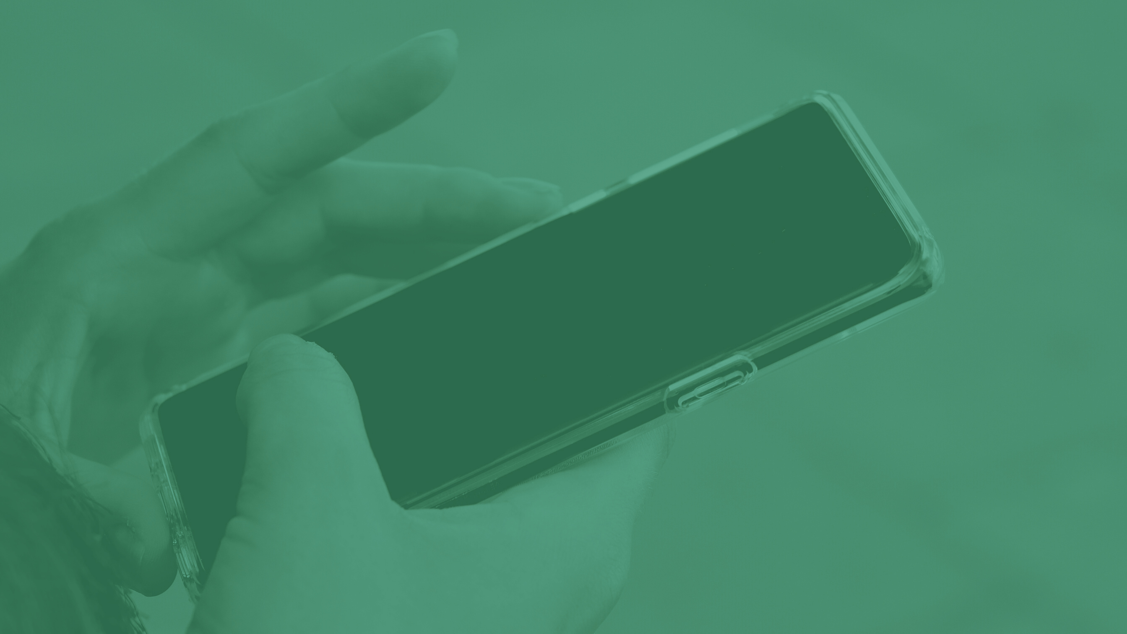

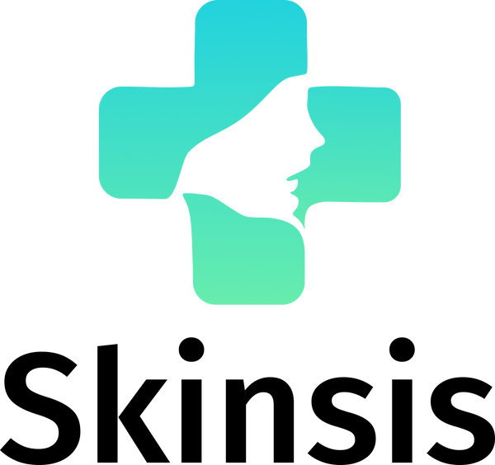


App for skin disease detection on facial skin
Capstone Bangkit 2022 | C22-PS236

Slide 2
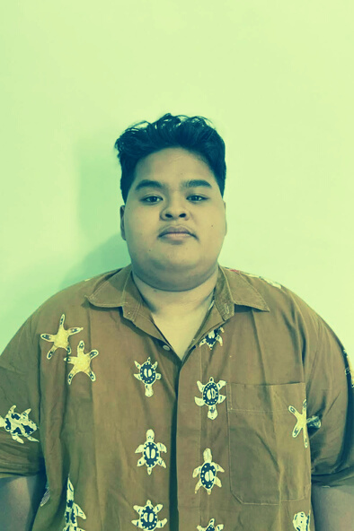
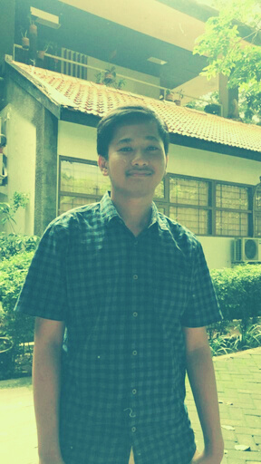
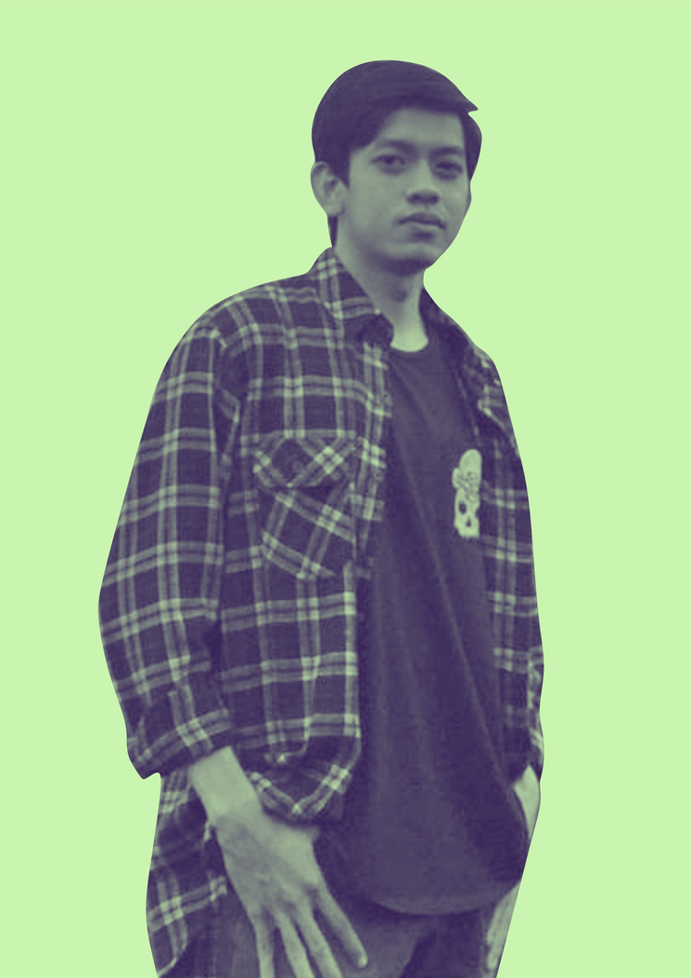
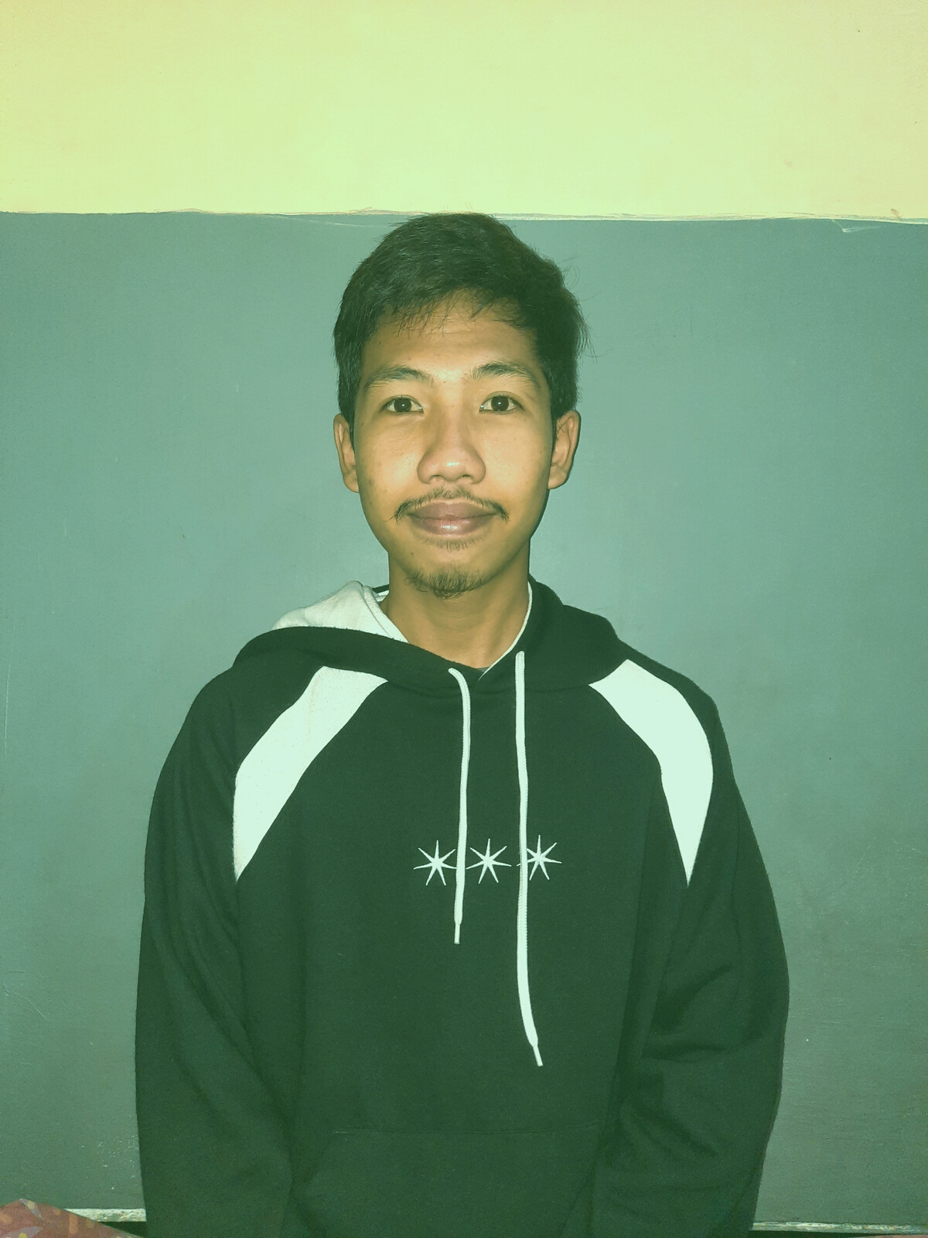
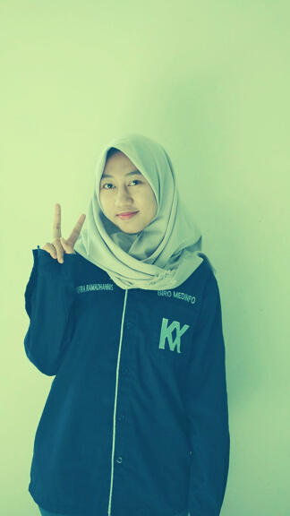
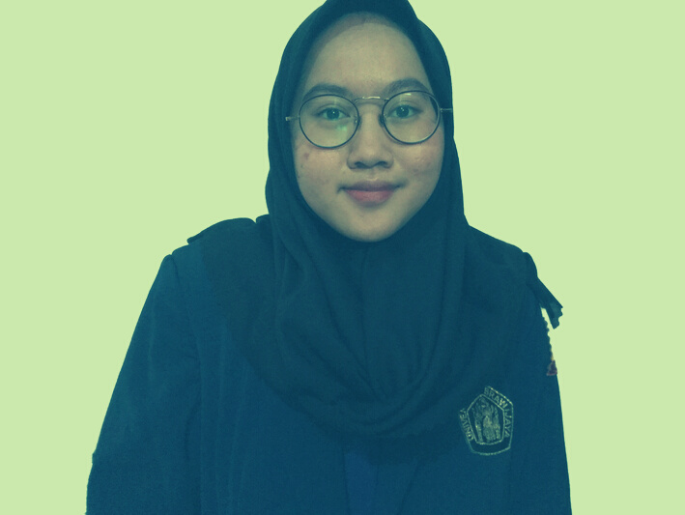
Meet the Team
I Komang Pande P. W. P.
Bramandika
Machine Learning
Machine Learning
Muhammad Syahril A.
Ahmad Fikri F.
Cloud Computing
Cloud Computing
Nafira Ramadhannis
Elsa Berliana O.
Mobile Development
Mobile Development

Slide 3
What Skinsis is trying to solve
Problems
The third rank of the ten most diseases in outpatients in hospitals in Indonesia.
Getting to and from hospitals and clinics can be burdensome
Occupational skin diseases and serious impacts and increase health costs and reduce quality of life
Finding the provider that's best for you is like hunting for a needle in a haystack
Reported from Indonesia Health Profile Data 2010
(Afifah, 2012)

Slide 4
750
Statistic
500
Skin disease statistics every year (Oktaviani, 2015)
250
0
2012
2013
2014

Slide 5

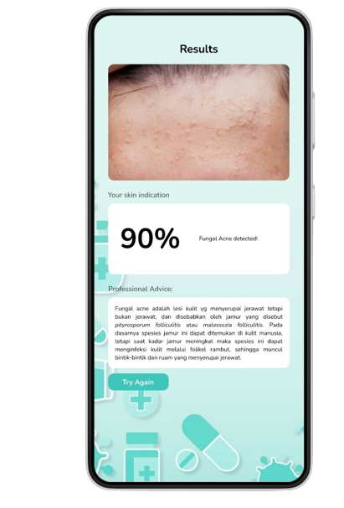


Skinsis in Action
Solutions
First Aid App
Identify first aid in dealing with skin diseases
Recommendations from a dermatologist
Recommendations given by dermatologists as an early diagnosis of the disease
Inform the accuracy of the disease with a percentage
Advice and input from experts could be targeted accurately

Slide 6

Skinsis
Your personal skin doctor

Slide 7
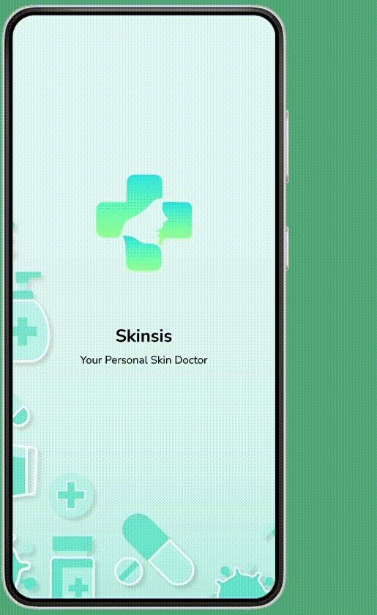
Goals
Skinsis's goals in action
1
FAST HANDLING
2
SOLUTION APPLICATION
3
TRUSTWORTHY AND RELIABLE

Slide 8
The Skinsis Ethos
01
02
03
Provide convenience in accessing skin health
The latest technology that is convenient and fast
Better patient experience
Dermatologist-supported application that is reliable in providing fast treatment
Technology and health care work hand in hand to provide
the best care for patients
Patients should get the best care in the best possible setting

Slide 9
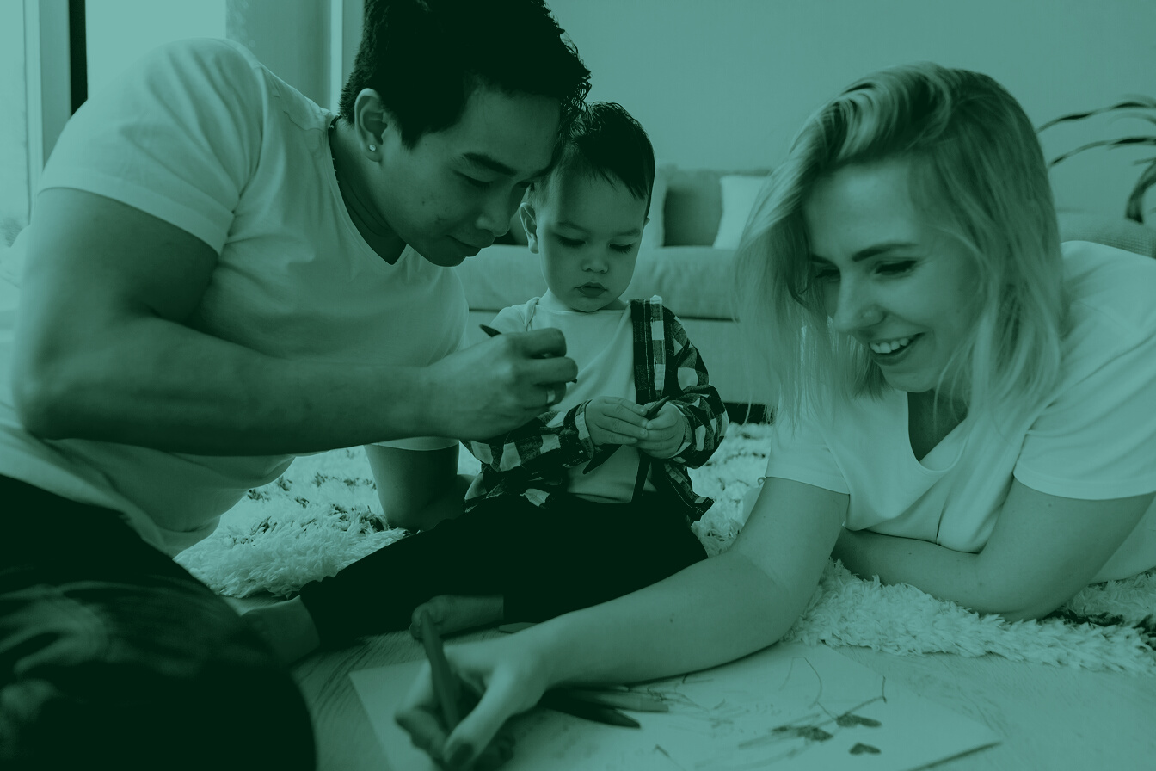
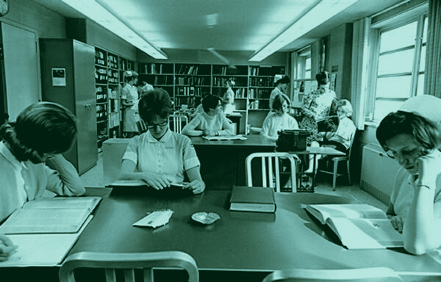
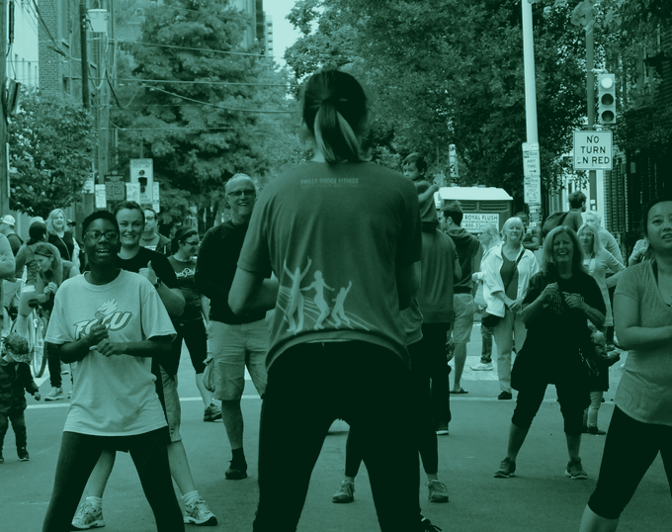
Who We Serve
Target Market
Android User Teenager
Android users with an age range of 13-30 years. However we still accept people above those age.
Healthy People Community
People who likes to prioritize their health including skin and appearence

Slide 10
Market Size
89,132
45,622
43,509
15 - 34 YEARS OLD
INDONESIAN PEOPLE
MAN INDONESIAN PEOPLE
WOMAN INDONESIAN PEOPLE

Slide 11
Why Your Target Market Needs Your Solution?
Early Prediction
Easy To Use
Tell What To Do
using machine learing to predict what kind of disease before the doctor's diagnosis
User can use apps anytime anywhere as long as connected with internet
We will give an instruction how to deal with the disease

Slide 12
Direct Competitors
Indirect Competitors
Miiskin Skin Tracker & eHealth
System Akvile skin health app
Troveskin
Aysa
Ms Glow App

Slide 13
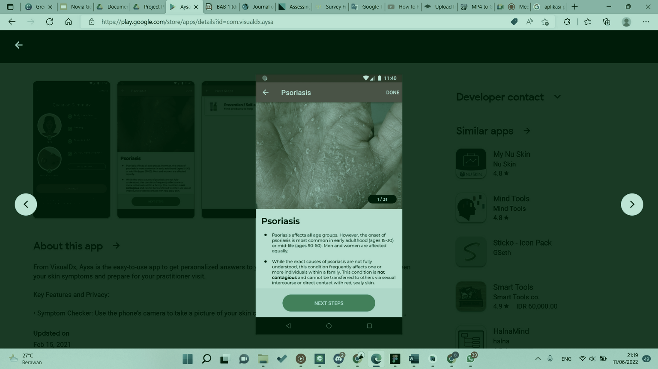
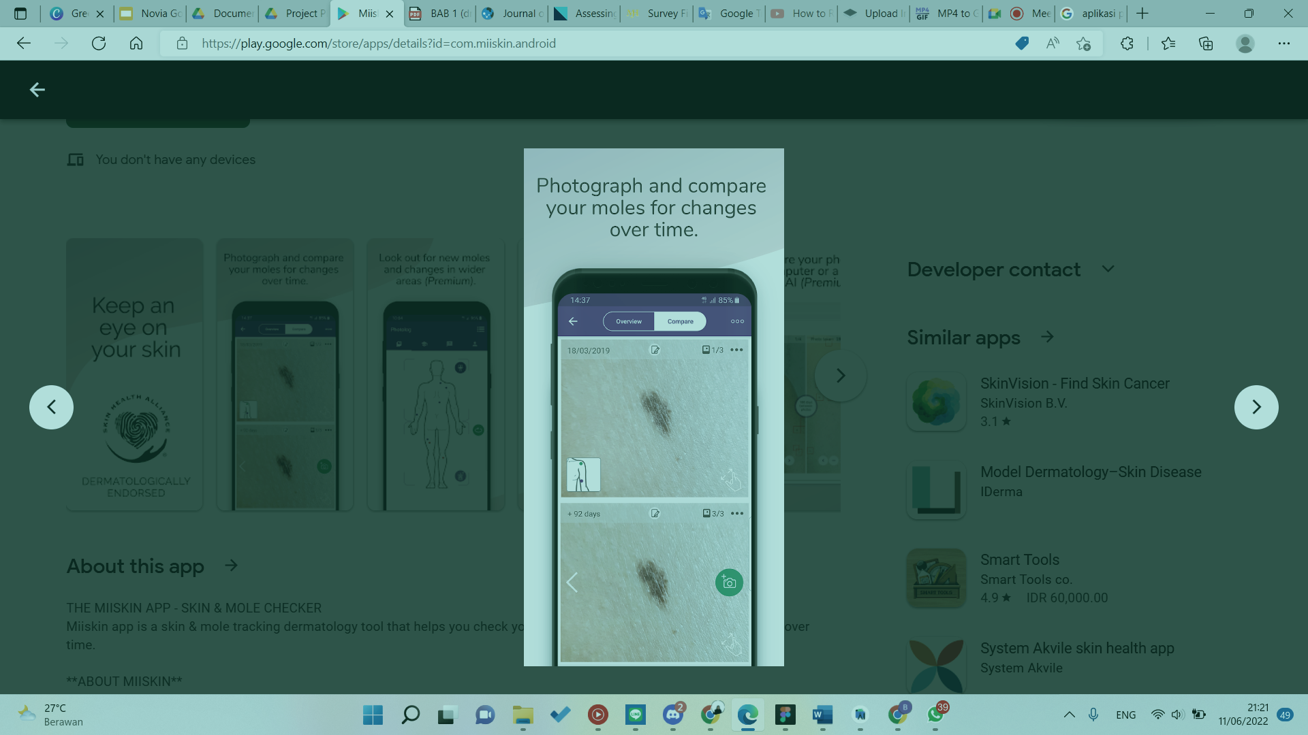
Comparison to Competitors
Aysa
Miiskin
There is no article and does not display disease accuracy to the user
This app does not provide solutions to users

Slide 14
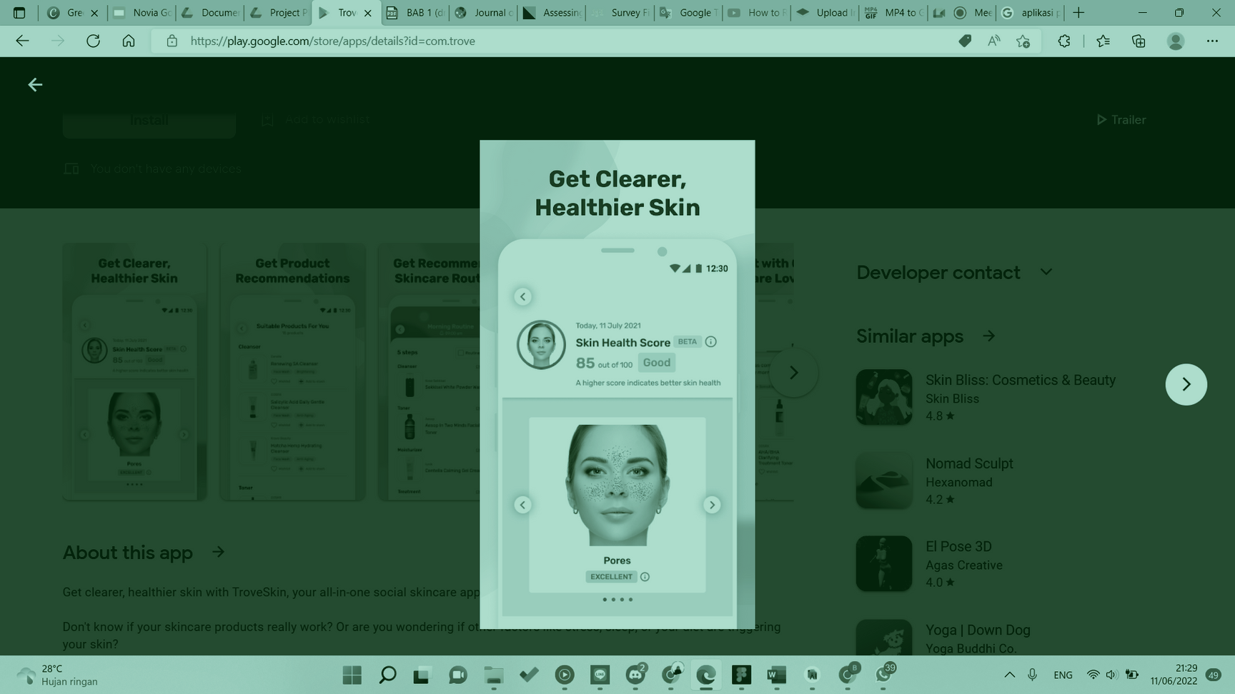
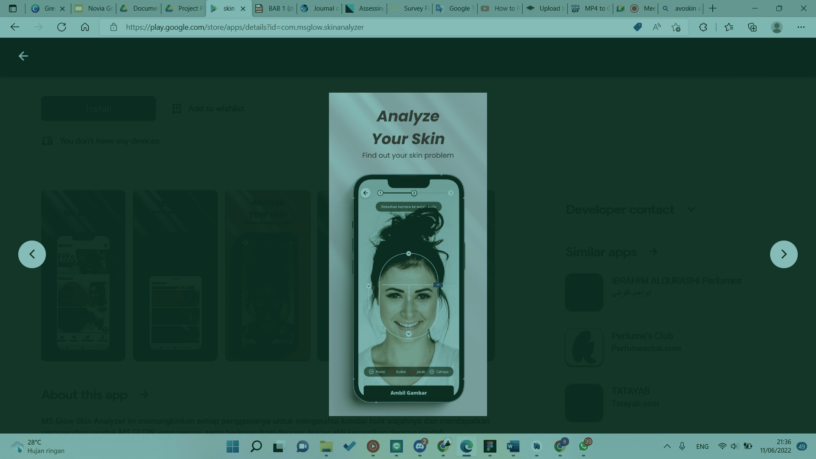
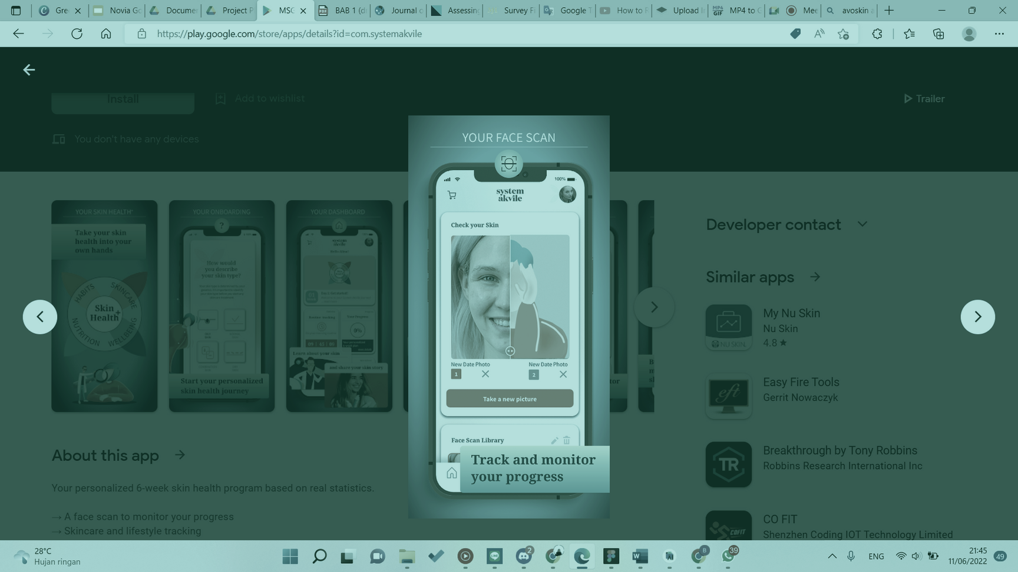
Comparison to Competitors
Troveskin
Ms Glow App
System Akvile
There isn't dermatologist's advice to solve skin problem
Too much bugs and server isn't working properly
There isn't dermatologist's advice and how to cure skin problem

Slide 15
Competitor Approach
Sponsorships
Events
Traditional and Digital Marketing
Collaborations with well-known dermatologists and skin care companies
Conduct events like medical missions and conferences
Hybrid marketing to raise awareness

Slide 16
Business Model
The Skinsis Way
Advertisement
Collaboration
Premium Account
advertising from clients on the application
Collaboration with a beauty company
Users can avoid ads and can use it more than 3 times a day.

Slide 17
Project Milestone in 2022
Skinsis next steps
July
September
November
FIXING BAKCEND OPTIMIZE MODEL
TESTING & EVALUATE PRODUCT
LAUNCHING PRODUCT ON PLAY STORE

Slide 18
Future Plan Product
Skinsis for future
2023
2024
2025
NEW FEATURE ADD RECOMENDATION DERMATOLOGIS EXPERT
NEW FEATURE ADD CHATBOT
BECOME MEDICINE & SKINCARE ONLINE SHOP

Slide 19

Possible Pilot/Trial
On the next 6 months
Timeline/Budgeting
Implementation
Timeline
Budgeting
Fixing the App
July - August
Rp 2.000.000,-
Testing Beta App
September - October
Rp 5.000.000,-
Launching the App
November
RP 13.000.000,-
500 Download App
December
Rp 20.000.000

Slide 20
Budgeting 1 - USD 5k (IDR 70m)
Category
Proportions (Max)
Budget (Max) in USD
Team Salary
35%
$1.750 / Rp24.500.000
65%
$3.250 / Rp45.500.000
Research / Operational
Buying/renting things
Prototyping
Cloud Infrastructure
Survey/FGD/data collections
Additional expenses for external experts, observer, respondents
Productions preparations, tooling
Legalities, patent/copyright registration, product certification

Slide 21
Budgeting 2- USD 10k (IDR 140m)
Category
All aspects covered in Budgeting - 1
Proportions (Max)
Budget (Max) in USD
Additional Budget for Team Salary
50%
$5,000 / Rp 70.000.000
5%
$500 / Rp 7.000.000
Market research and competitive analysis
Marketing and Sales
10%
$1,000 / Rp 14.000.000
Future Development / R&D
$500 / Rp 7.000.000
5%
Other Expenses (taxes, reserves)
20%
$2,000 / Rp 28.000.000
10%
$1,000 / Rp 14.000.000

Slide 22
Sustainability
Sources of Income
Project (proyek): Depend on the contract
Subscription : @Rp14.999 x User
Rounds of Funding (pembiayaan): Rp 140.000.000
Efficiency Priority
Running with bare-minimum operations
Reducing overhead and unnecessary costs
Subscriber and advertisement
Using appropriate services and third-party vendors

Slide 23
Expectation from Budgeting
5k Funding
10k Funding
Expected Runway: 6 months / 0.5 years
Expected Headcount: 6 people
Assets:
Patent or copyright applications
Data: Disease, dermatologist information
Expected Runway: 10 months / 0.83 years
Expected Headcount: 10 people
Market Positioning: 5.000 users
Assets:
Knowledge / trained persons: 10
Data: Disease information improving, dermatologist location, information of dermatologist advice, skin care recommendation from dermatologist

Slide 24
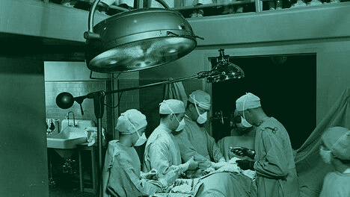
Skinsis
Application Creation Process

Slide 25



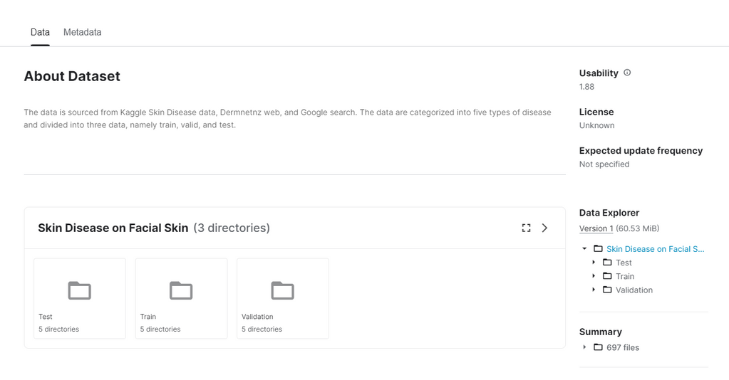
Machine Learning
Dataset
Data collected from various website such as:
Data contain 5 labeled image of skin disease which have been published to kaggle
dermnetnz.org
kaggle.com
google.com
Dataset can be downloaded here: https://www.kaggle.com/datasets/ikomanggg28/skin-disease-on-facial-skin

Slide 26
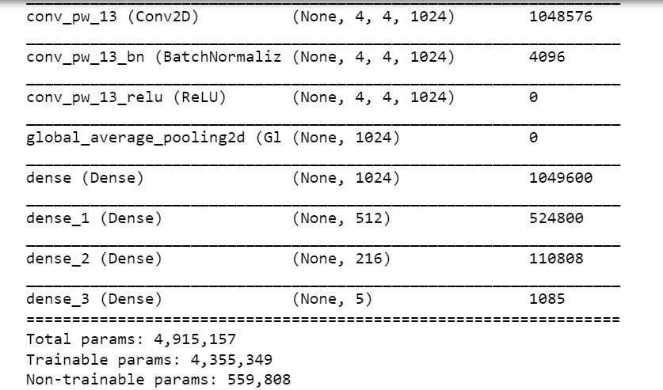

Machine Learning
Transfer Learning with Mobile net
This Machine Learning model using CNN Architecture which will process the image and classify it.

Slide 27


Result Machine Learning
Train Accuracy
Validation Accuracy
Test Accuracy
99.12%
85%
75.68%
Train Loss
Validation Loss
Test Loss
0.0243
1.02101
1.5469

Slide 28





Cloud Computing Service
SERVERLESS
Cloud Run
STORAGE
Cloud Storage
FIREWALL
VIRTUAL PRIVATE CLOUD
API
FLASK

Slide 29

Designing Architecture Application
RESTful API is an implementation of the API (Application Programming Interface). And REST (Representational State Transfer) is an architectural communication method that uses the HTTP protocol for data exchange and this method is often applied in application development.

Slide 30
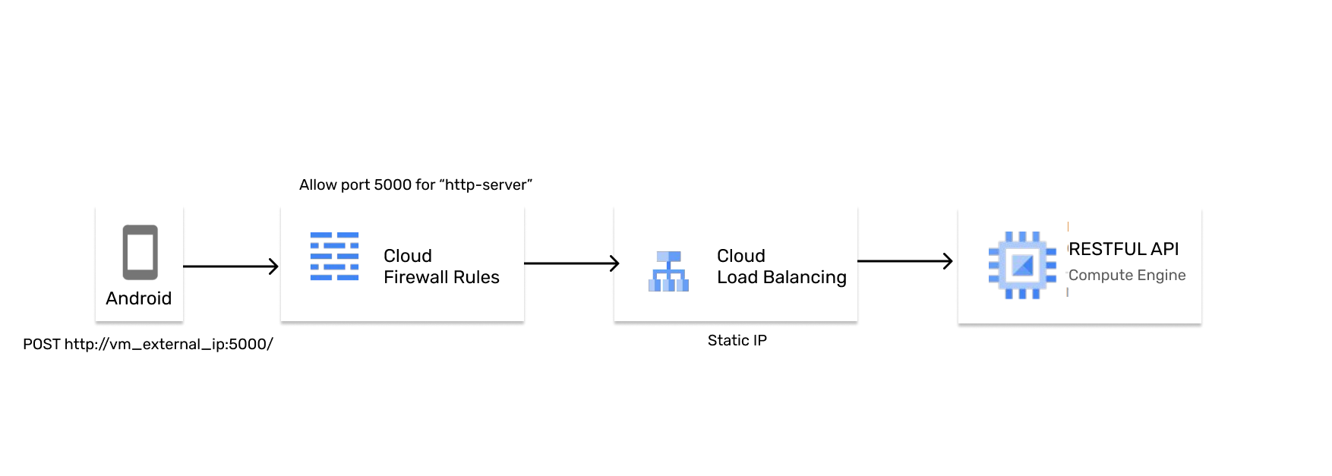
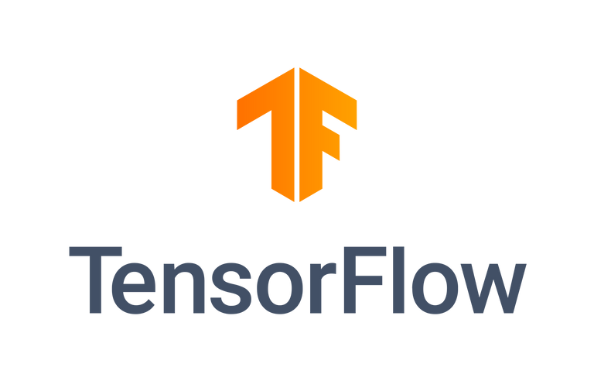
Architecture Application

Slide 31

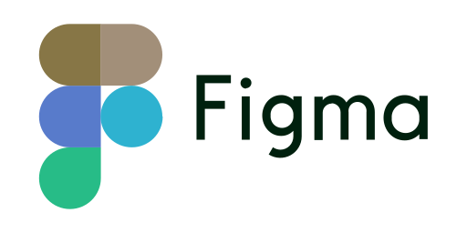


Mobile Development
There are some of the tools we use

Slide 32

Deployment
GitHub
https://github.com/nafirar/skinsis-skin-face-disease-detection
https://github.com/nafirar/skinsis-skin-disease-detection-ML-Model
https://github.com/nafirar/skinsis-skin-disease-detection-API-Cloud
● Android 8.1 Oreo
Requirement
● Camera minimum 8 MP
● RAM minimum 2 GB

Slide 33
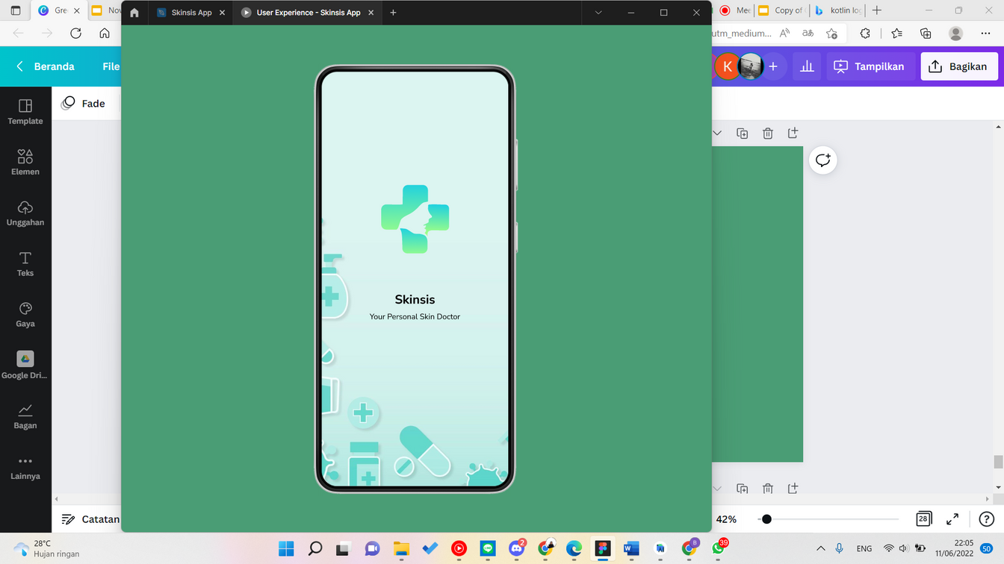
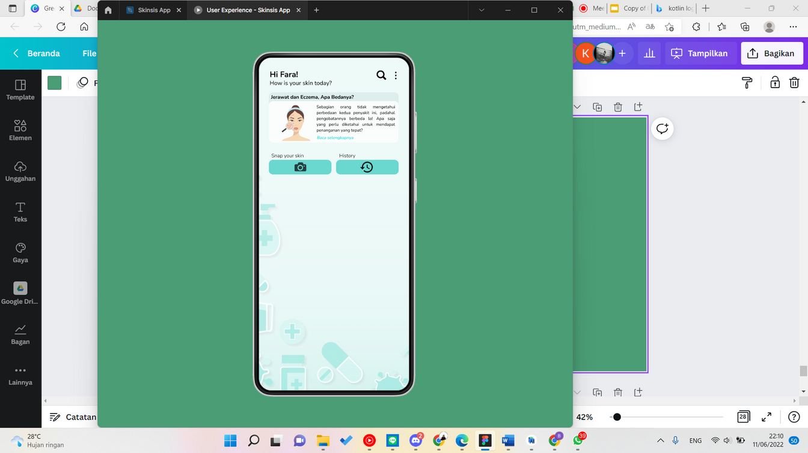
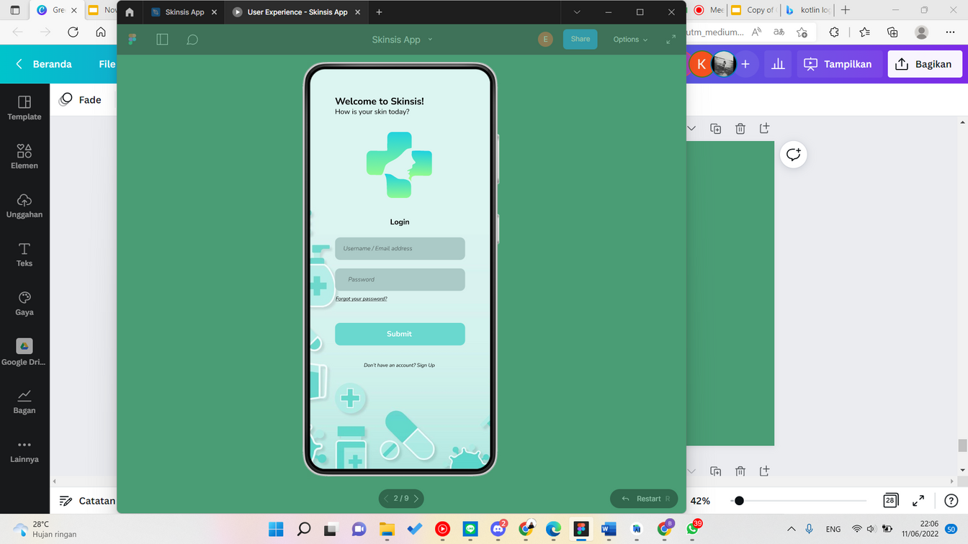
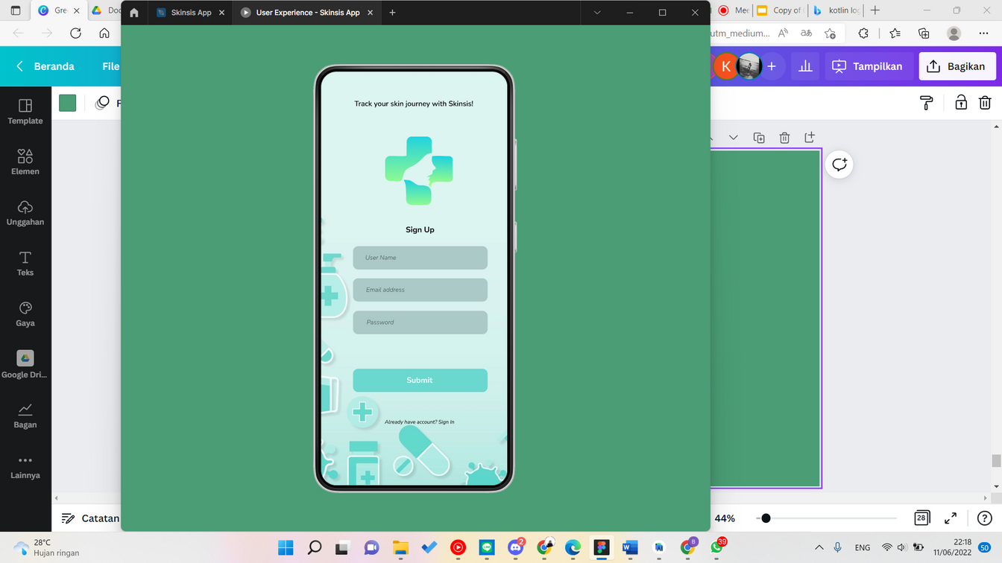
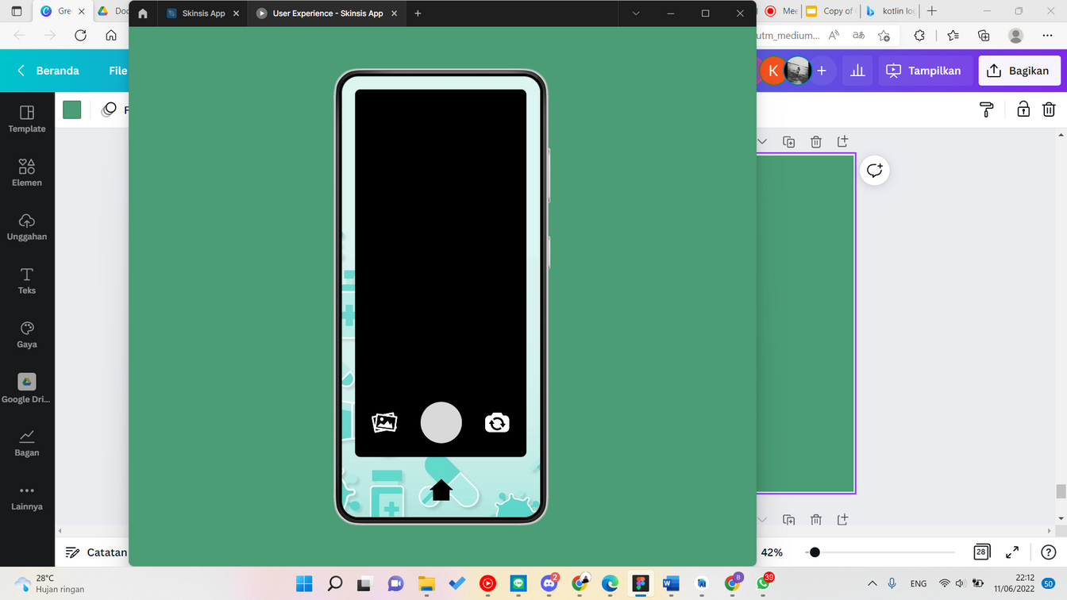
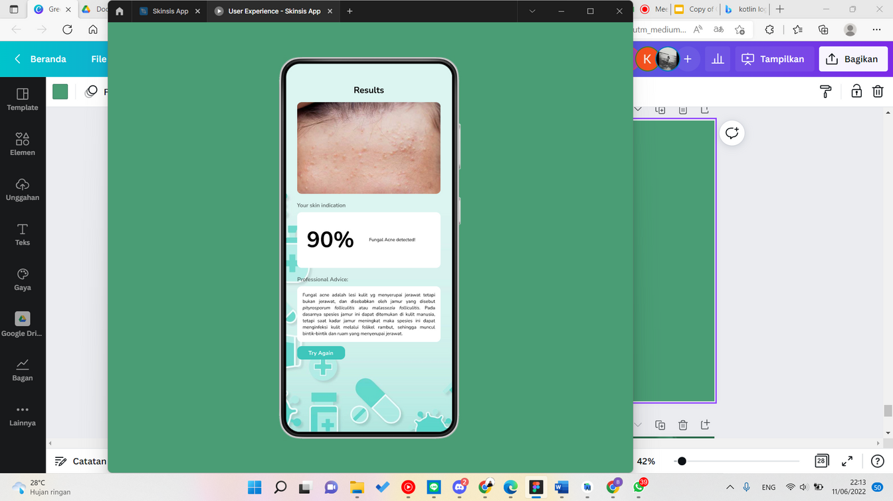
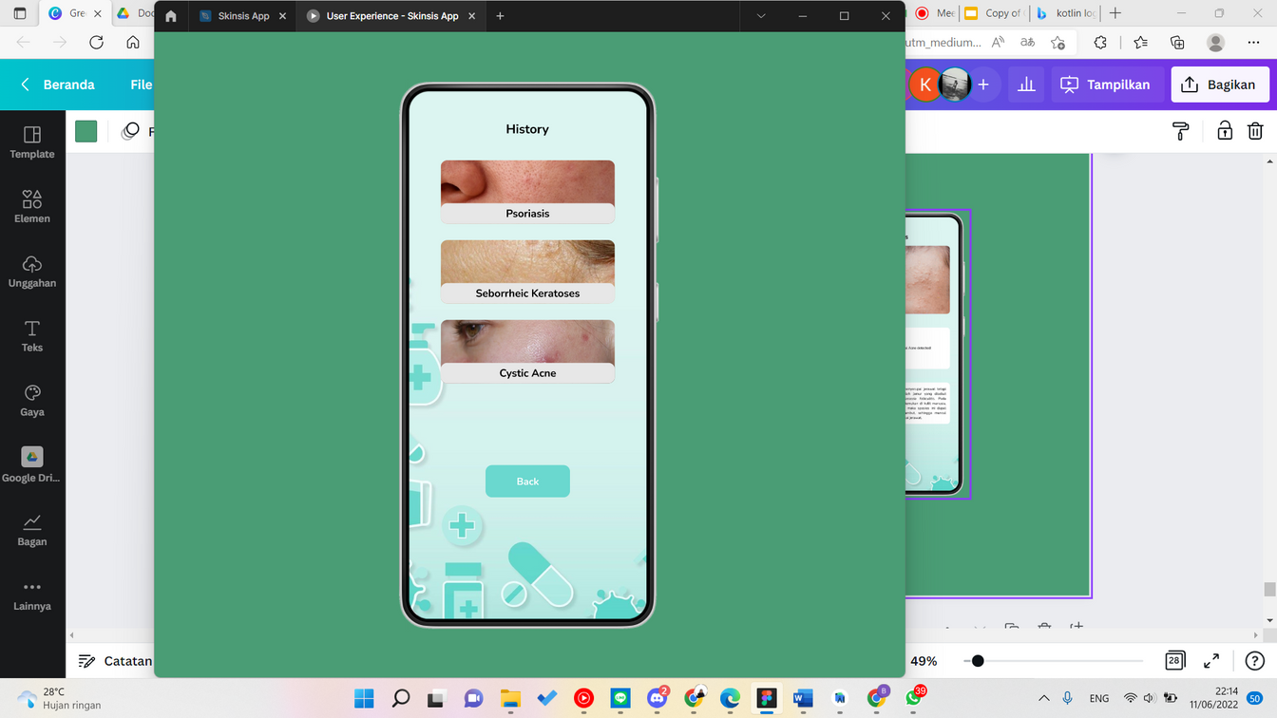
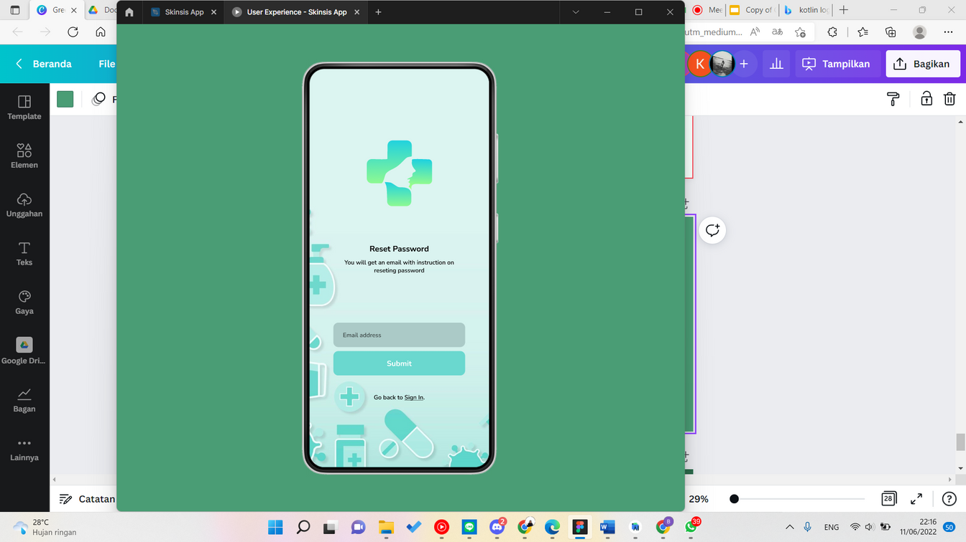
Application
Layout

Slide 34
Quick Demo

Slide 35


Slide 36

Thank You

